Slide 1



EE321 Final Project: Zumo Robot Object Detection and Counting
Exploring the challenges and solutions in programming a Zumo robot to autonomously navigate an arena, detect objects with infrared sensors, and count them using LED blinks.

Slide 2
Team Members
Çağatay DURU
Emirhan BENDERLİ

Slide 3
Project Components
Zumo Robot Platform
MZ80 Infrared Sensor
The core component of the project, a compact and maneuverable Zumo robot chassis equipped with various sensors and motors.
A high-precision infrared sensor used to detect and identify objects within the robot's scanning radius.

Slide 4
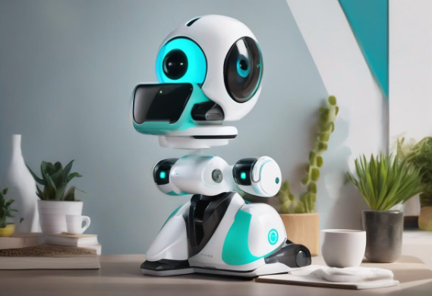
User Manual
Power
Insert 6 x AA batteries into the battery compartment to power on the Zumo robot.
Calibration
Press the on button to start the 5-second calibration process. Show both white and black ground to the reflectance sensors at the front bottom of the Zumo.
Placement
After calibration, place the Zumo anywhere inside the arena. The center is ideal, but avoid obstacles. Ensure the Zumo is completely inside the arena to prevent it from falling out.

Slide 5

Challenges Encountered
The project presented several key challenges, including accurately calibrating the MZ80 infrared sensor, developing a search algorithm to navigate the arena, and reliably detecting arena borders and obstacles.
Sensor calibration was critical to ensure consistent and accurate object detection, while the search algorithm had to account for various arena shapes and object placements.

Slide 6
Flaws and Limitations
1
Knocked Down Objects
2
Detection Range
3
Code Customization
Distant objects may not be detected, requiring increased MZ80 range.
Knocked down objects might cause miscounting.
For different cases, some variables in the code need to be tweaked.

Slide 7

Components and Libraries
Our project utilizes various components and libraries to enhance the functionality of the Zumo Robot. These include the MZ80 Infrared Sensor, 6 Reflectance Sensors, and a Buzzer. In addition, we make use of the ZumoShield.h library, which includes the QTRSensors.h, ZumoMotors.h, ZumoBuzzer.h, and ZumoReflectanceSensorArray.h libraries. These components and libraries play a crucial role in achieving our project goals.

Slide 8



Sensor Calibration
Sensor Positioning
Carefully positioned the MZ80 infrared sensor to ensure optimal coverage of the arena for object detection.
Sensitivity Adjustments
Needs adjustments the sensor's sensitivity for different cases and accurately detect objects of varying sizes and distances.

Slide 9
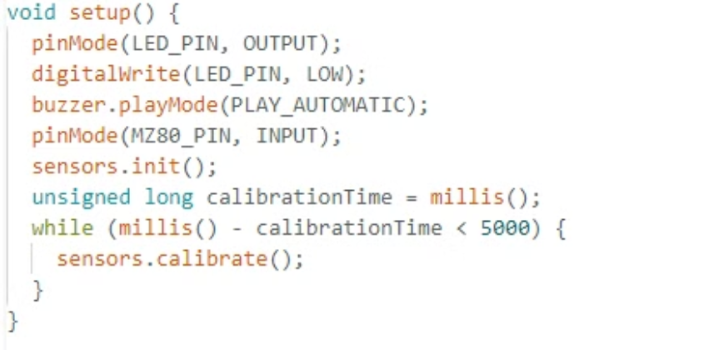
Method: Calibration
Essential to prevent the Zumo from falling out of the arena.
5-second calibration to differentiate between white borders and black ground.

Slide 10



Search Algorithm Development
Explore
1
Scan the arena perimeter
Detect
2
Identify object locations
Knock Down Objects
3
Count objects
We developed a simple search algorithm to systematically scan the arena, detect objects using the infrared sensor and use motors to knock down that object also counting

Slide 11
Method: Search Algorithm and Obstacle Detection
Robot turns alternately left and right, moves forward periodically.
Uses turnCount variable to track turns and handleBorderDetection() to stay within borders.
Zumo moves forward and continuously turns left if no white ground is detected.
On detecting an obstacle, it moves forward, knocks it down, counts it, and moves backward.
Buzzer sounds on object detection.

Slide 12
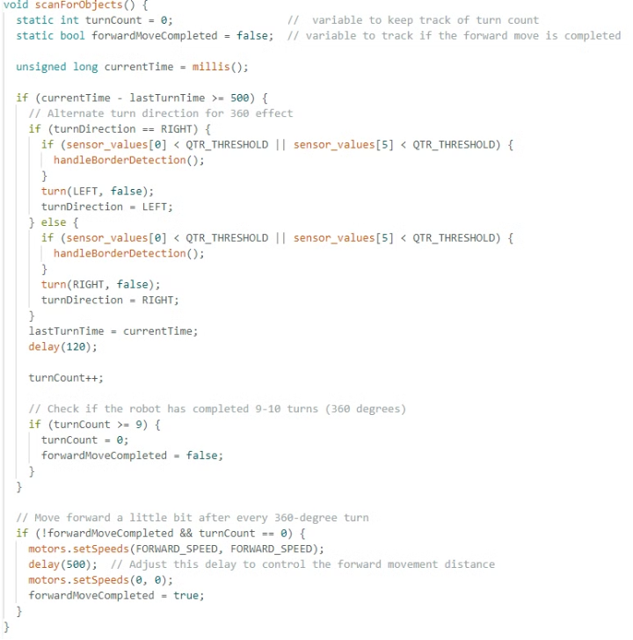
Algorithm Implementation
Below are snippets of the code used to implement the search algorithm of Scan for the Zumo robot:
Search Algorithm:

Slide 13
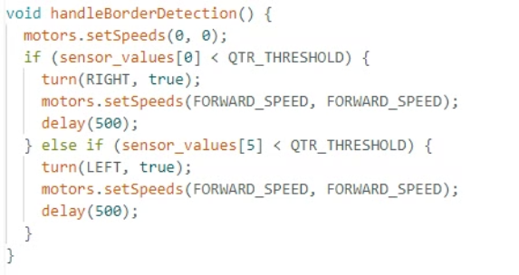
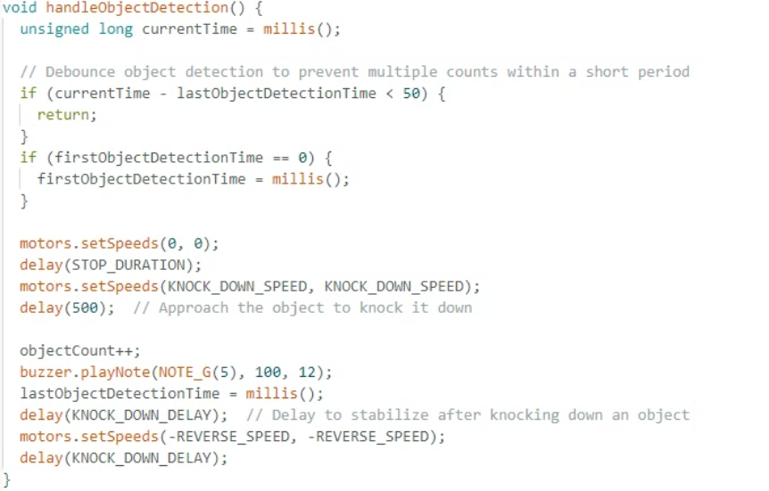
Algorithm Implementation
Below are snippets of the code used to implement the search algorithm and obstacle detection for the Zumo robot:
Turn and Border Detection
Object Detection and Counting

Slide 14
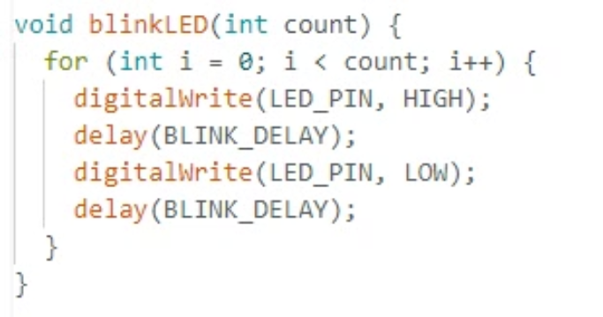
Method: LED Blinking
If no objects are detected for 45 seconds, the Zumo robot stops moving. The LED on the robot blinks a number of times equal to the number of objects counted. This visual indicator helps track object detection and counting progress.

Slide 15





Experimental Trials and Findings
The team continued their testing with additional experiments to assess the Zumo robot's object detection and counting capabilities. Here are the findings from the new test cases:
1
Experiment 1: Objects near edges
2
Experiment 2: Objects placed close together
3
Experiment 3: Center object surrounded by others
Zumo counted every object correctly, even when placed near the edges of the arena.
Zumo counted every object correctly, showing its ability to handle objects in close proximity.
Zumo miscounted due to knocking down multiple objects, indicating a limitation in its current design.
4
Experiment 4: Different sized objects near edges
5
Experiment 5: Obstacles arranged in a smile shape
Zumo counted every object correctly, demonstrating its robustness in detecting objects of varying sizes.
Zumo counted every object correctly, showing its ability to handle non-linear object arrangements.
Experiment 1
Experiment 2
Experiment 3
Experiment 4
Experiment 5

Slide 16


Insights Gained in Robotics Programming
Team Collaboration
Adaptability and Troubleshooting
The project demonstrated the value of good communication and teamwork in challenging robotic engineering projects, with each member providing special talents and viewpoints.
Because the test arena is unpredictable, navigating it showed that adaptive programming and fast problem-solving are necessary to guarantee the robot's dependable performance.

